Slide 1

Talking about homes (Parts of the house)
February, Friday 9, 2018
Teacher: Fábio Teixeira Varela

Slide 2
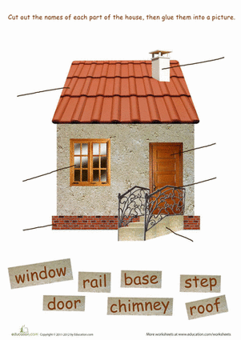

Slide 3
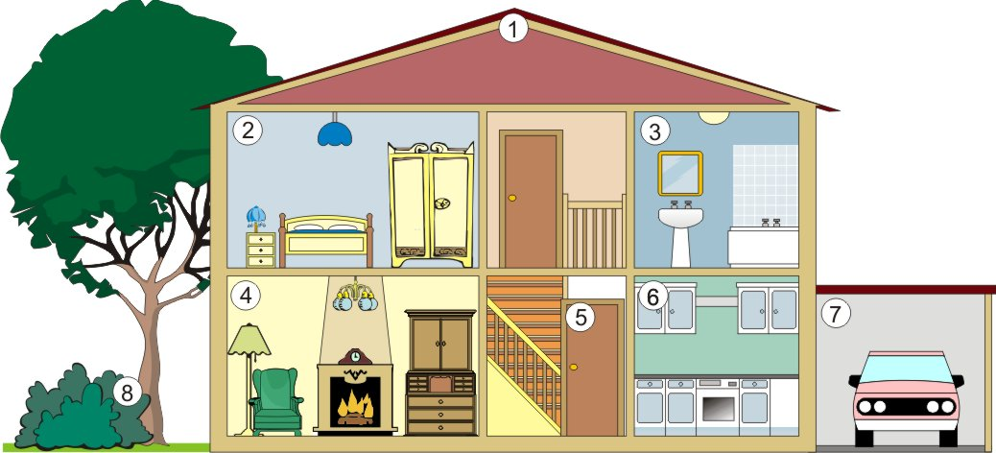

Slide 4
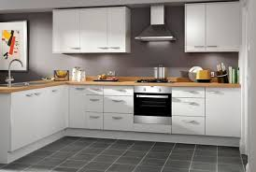
Kitchen
Kitchen

Slide 5
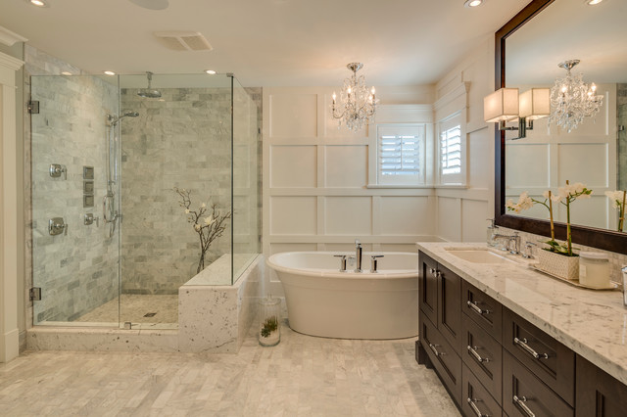
Washroom
Bathroom
Bathroom
Restroom
Toilet

Slide 6
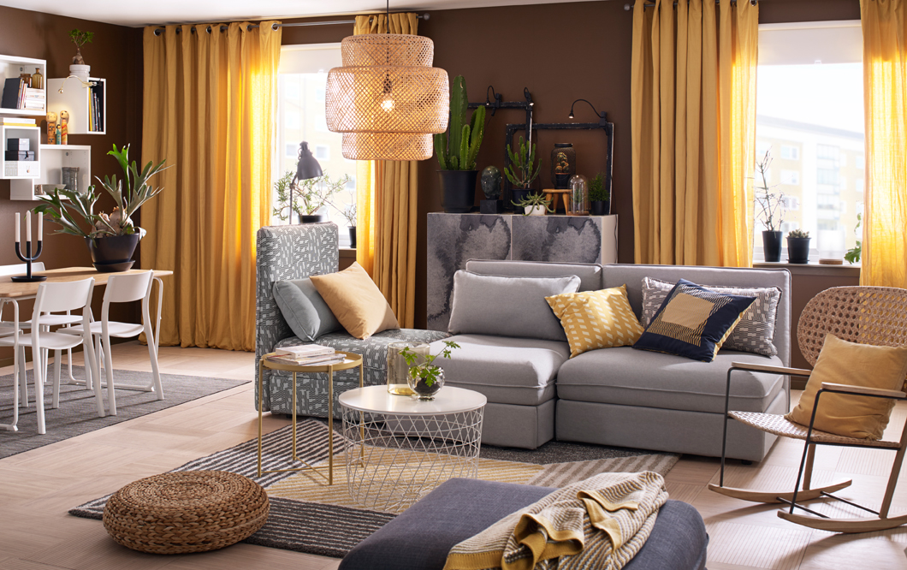
Living Room

Slide 7
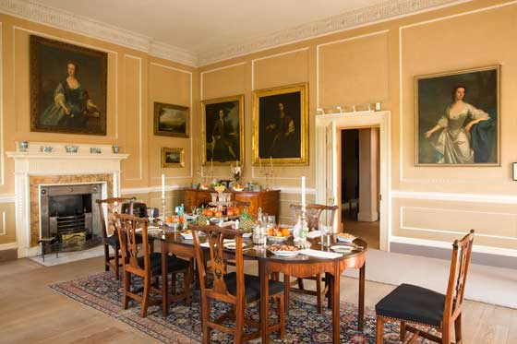
Dining room

Slide 8
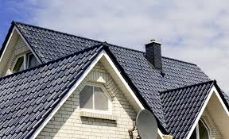
Roof

Slide 9
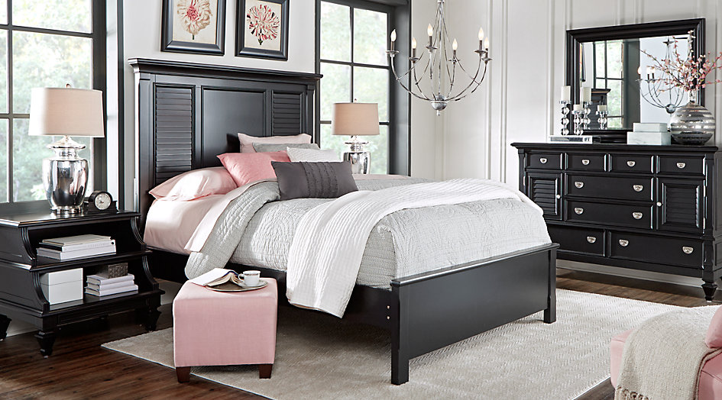
Bedroom

Slide 10
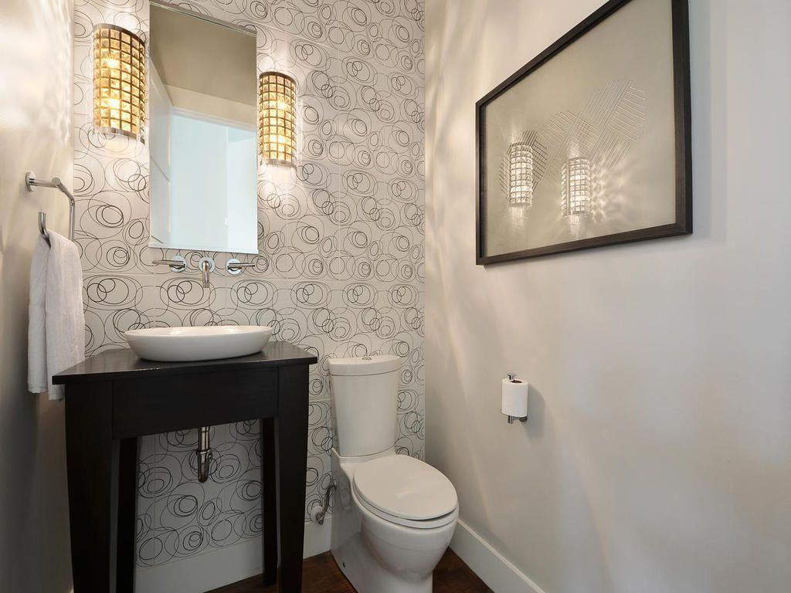
Powder room

Slide 11
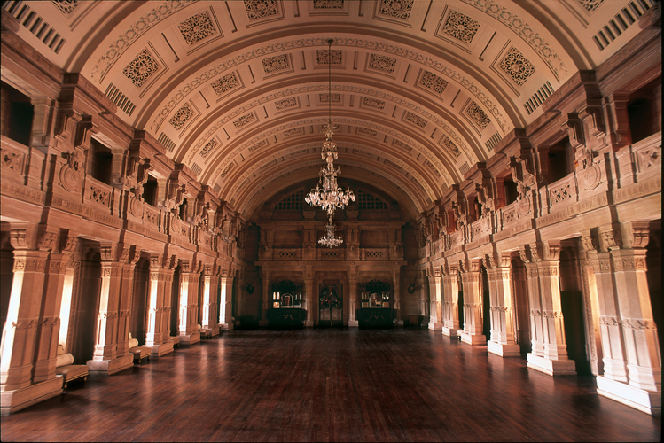
Hall

Slide 12
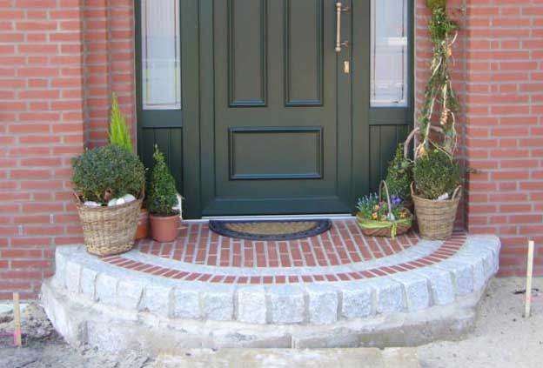
Doorstep

Slide 13

Terrace

Slide 14
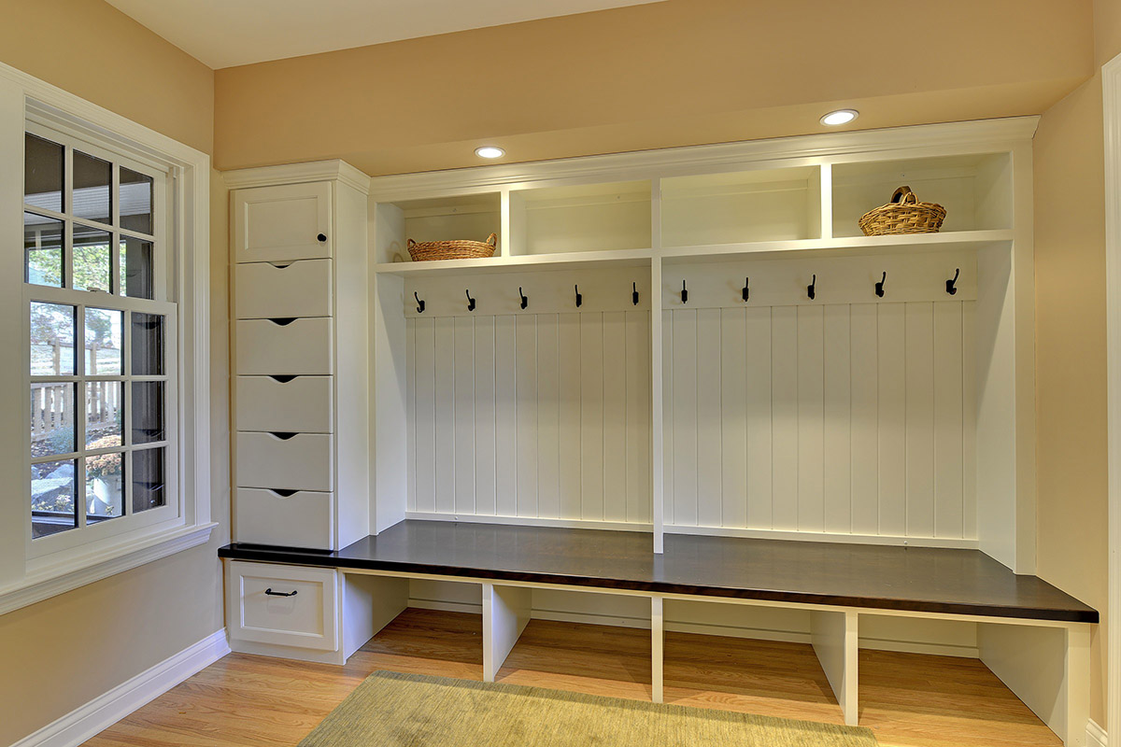
Mudroom

Slide 15
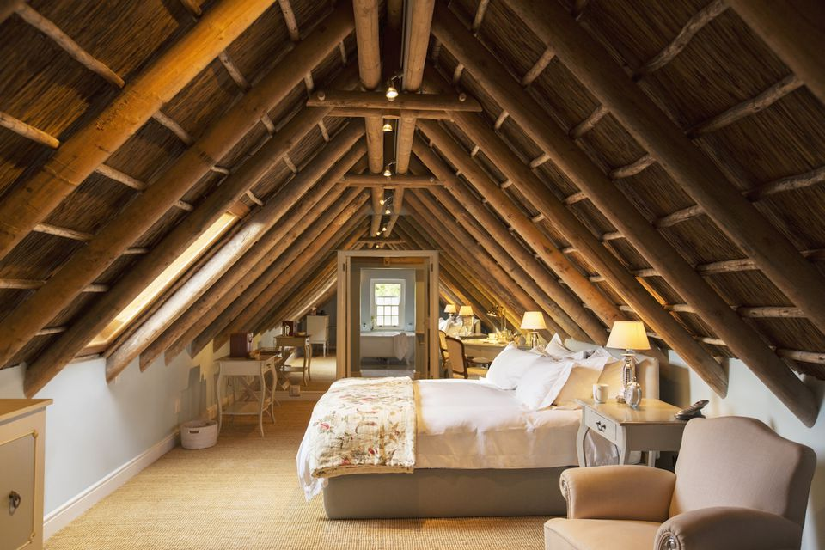
Attic

Slide 16
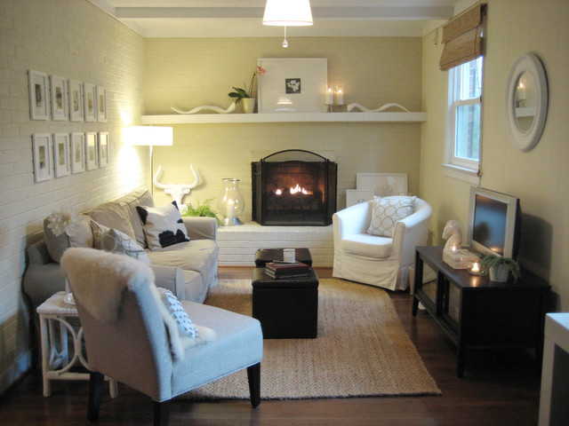
Den

Slide 17
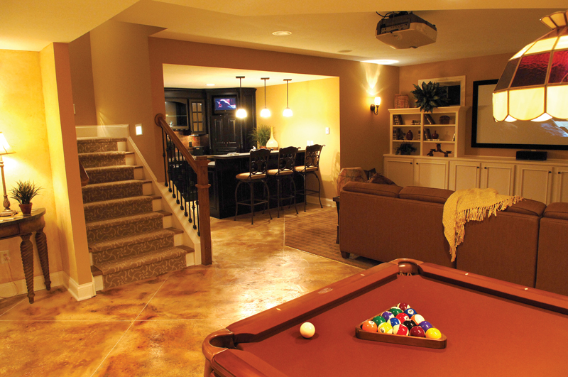
Basement

Slide 18
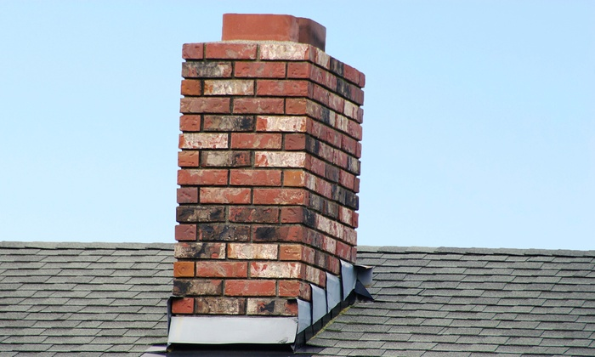
Chimney

Slide 19
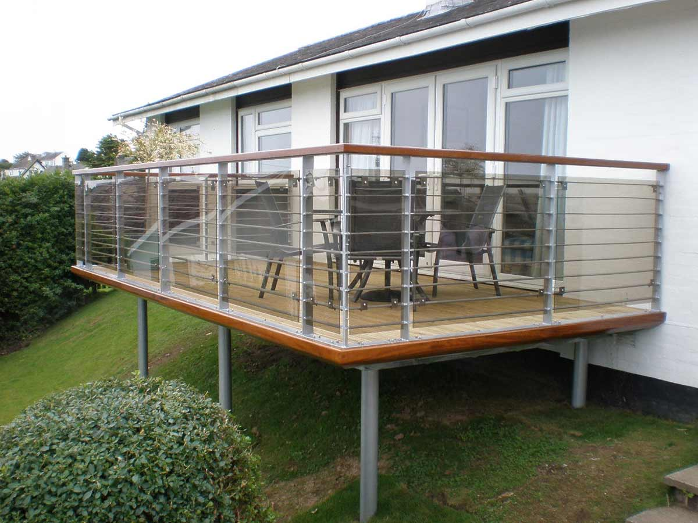
Balcony

Slide 20
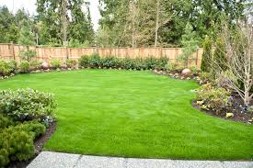
Backyard

Slide 21
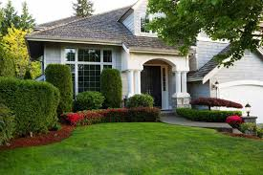
Front yard

Slide 22

Garden

Slide 23
