Slide 1
April 2018
Teacher: Fábio Teixeira Varela

Slide 6
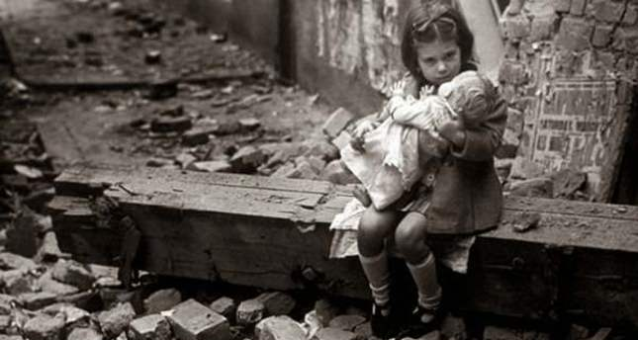

Slide 7
